Slide 1
Airbnb Data Analysis:
Lodge Prices
Tonghua Lin

Slide 2
CATALOG
1 Introduction
2 Data Cleaning
3 Explore
4 Regression Model
5 Insights
6 Conclusion and Extension

Slide 3
1 Introduction
2 Data Cleaning
3 Explore
4 Regression Model
5 Insights
6 Conclusion and Extension

Slide 4


Introduction
Besides the chain hotels, Airbnb is another way to find a lodge while traveling. This project is trying to find the factors that can influence the price of a lodge.

Slide 5

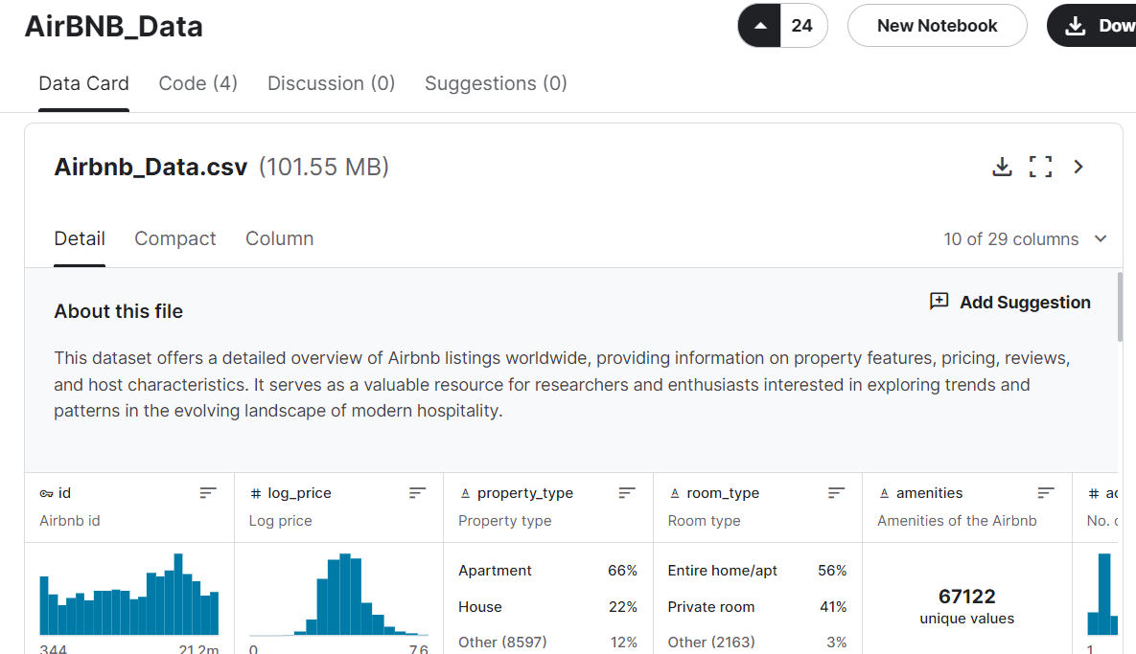
Introduction
29 columns and 73000 rows
ID
Log_price
Property_type
Room_type
Bathroom
City
….

Slide 6
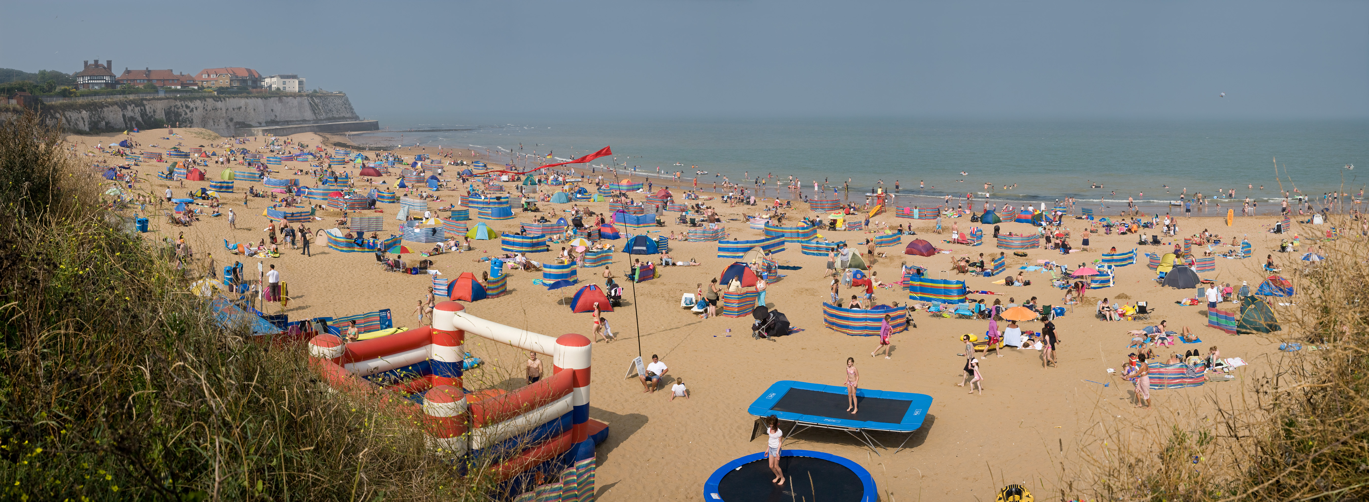
Introduction
Project Target:
Predict the price by different factors
Find a good city with low lodging prices

Slide 7
1 Introduction
2 Data Cleaning
3 Explore
4 Regression Model
5 Insights
6 Conclusion and Extension

Slide 8
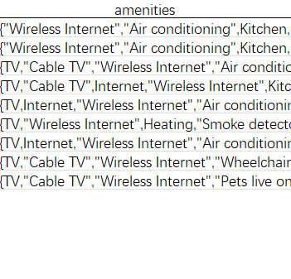
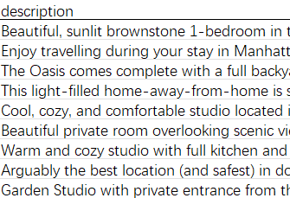
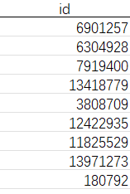
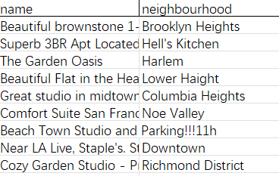
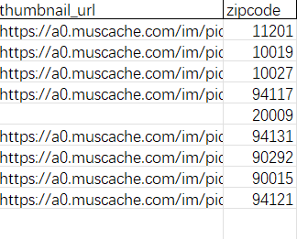
Data Cleaning
Exclude text data and location name related data:
id amenities description name neighbourhood thumbnail_url

Slide 9
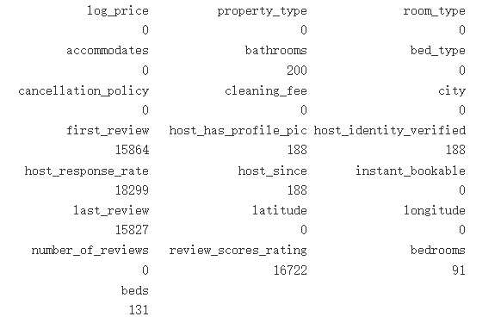
Data Cleaning
Deal with the NA missing data
For host_identity_verified related: Delete
For bathrooms: 0
For review related: 2017/11/01
For beds and bedrooms and scores: average

Slide 10
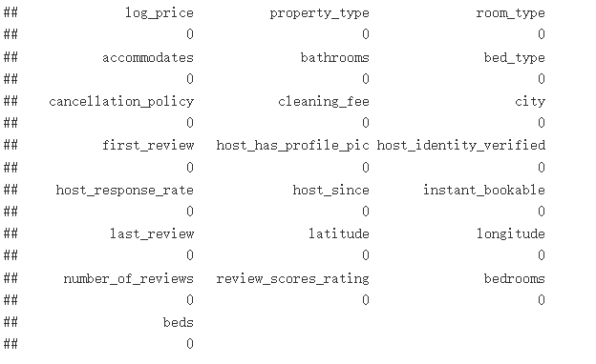
Data Cleaning
Deal with the NA missing data

Slide 11
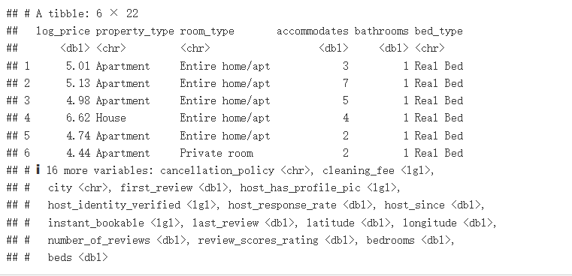
Data Cleaning
Transform the date data to number: using 2017/11/01 as baseline

Slide 12
1 Introduction
2 Data Cleaning
3 Explore
4 Regression Model
5 Insights
6 Conclusion and Extension

Slide 13
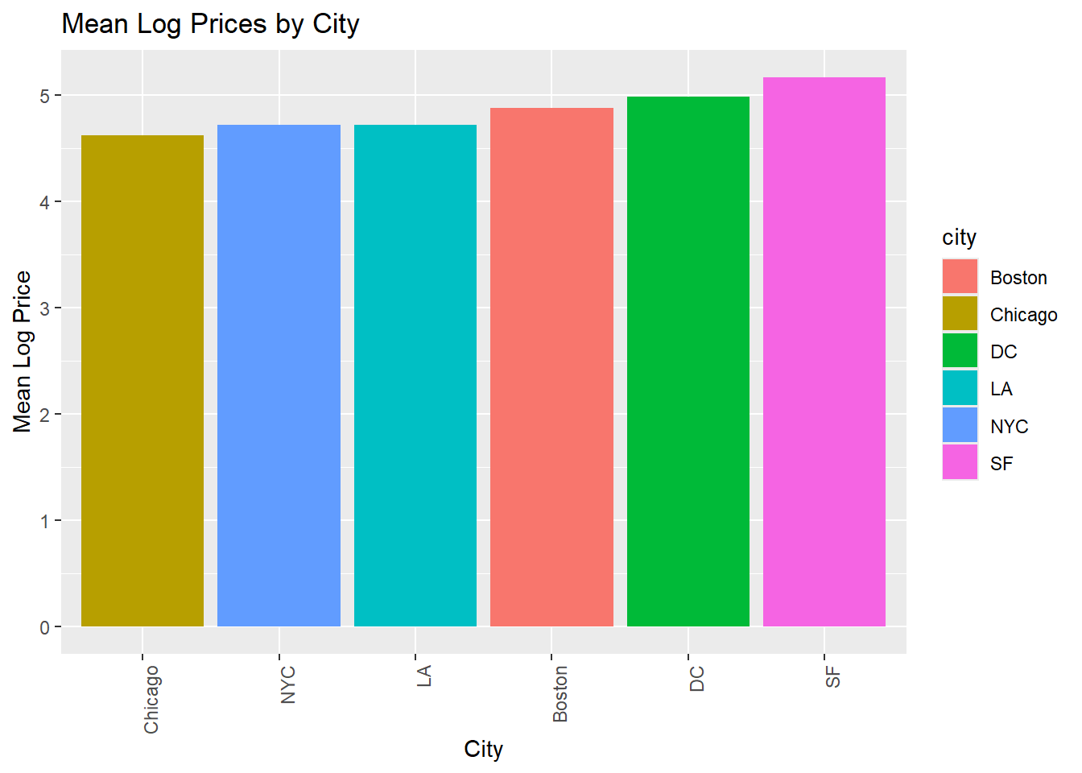
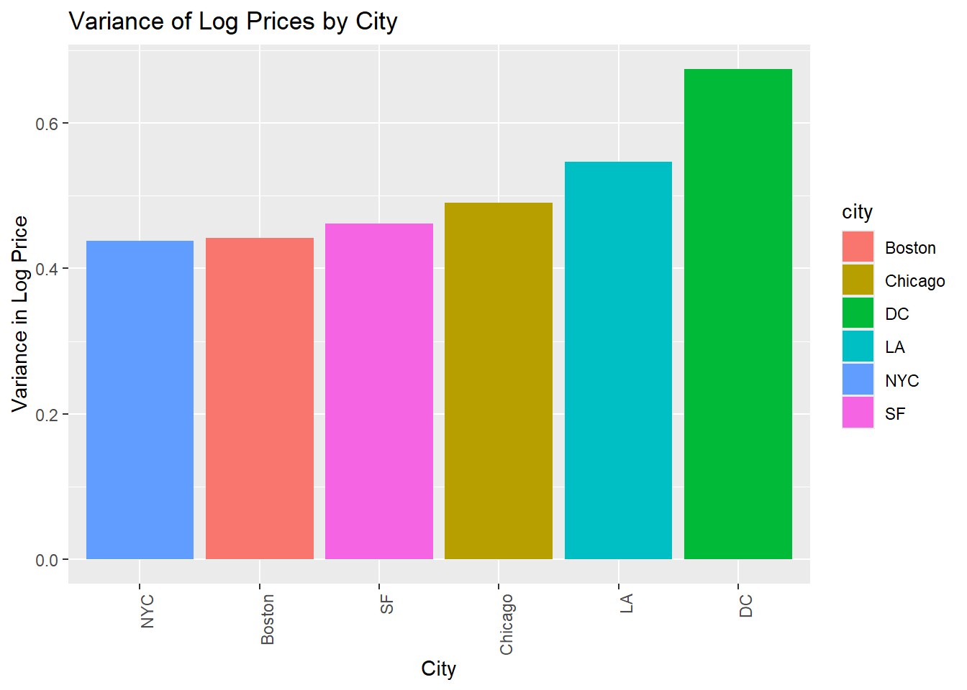
Explore
Means and variances across cities

Slide 14
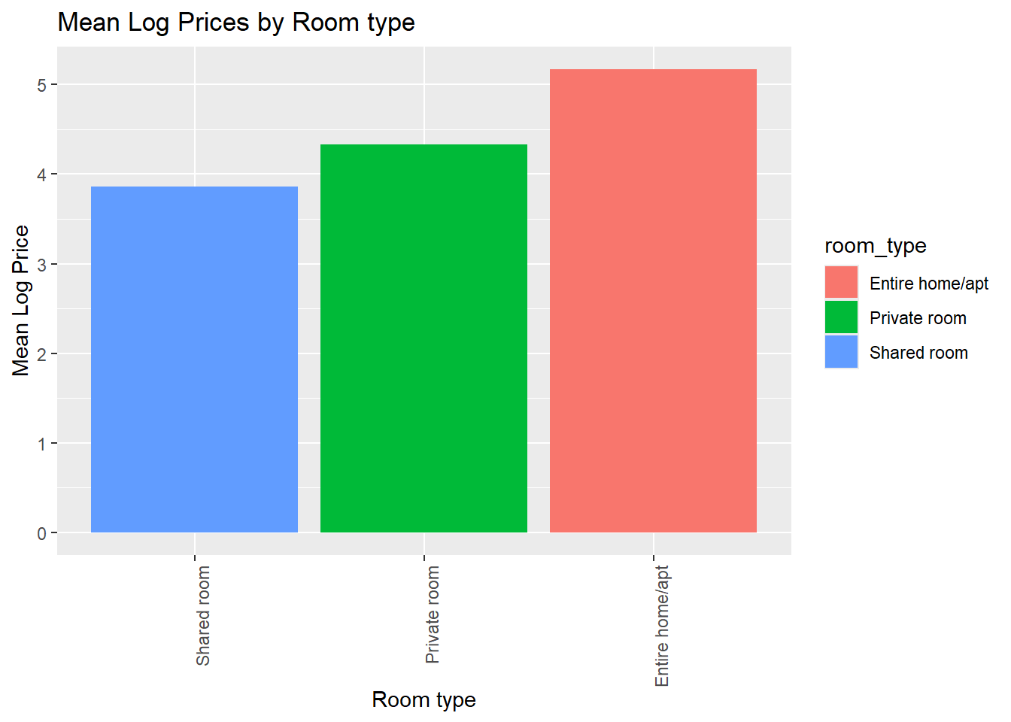
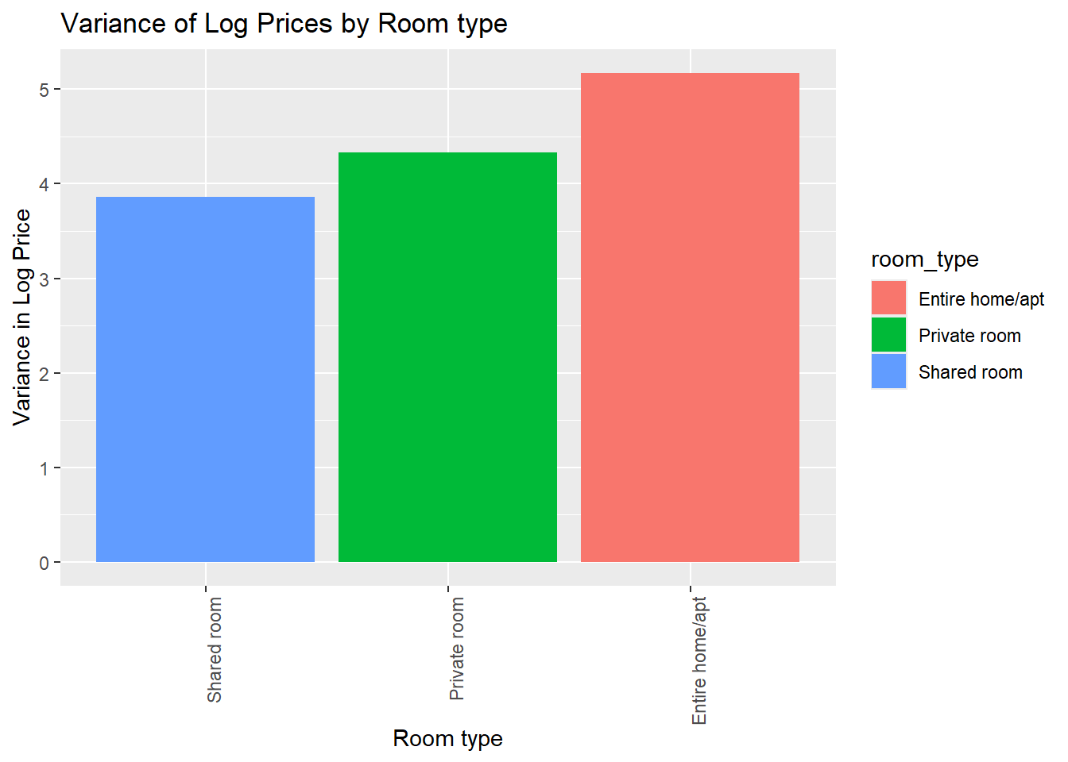
Explore
Means and variances across room types

Slide 15
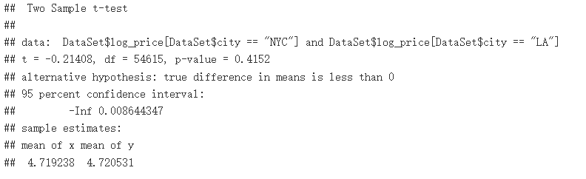
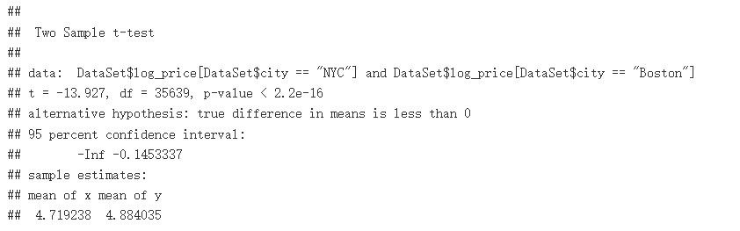
Explore
T-test results

Slide 16
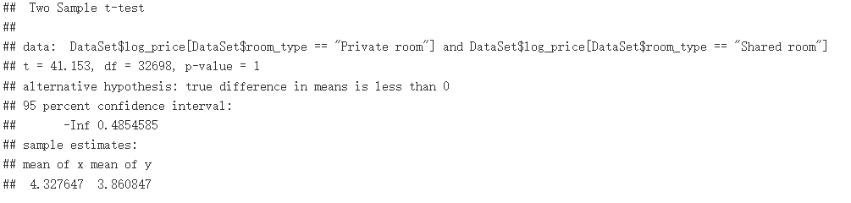
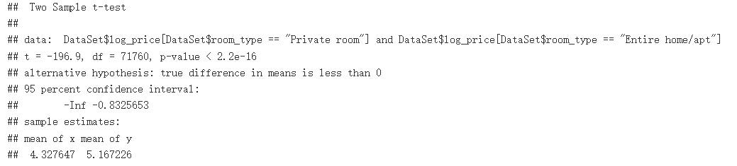
Explore
T-test results

Slide 17
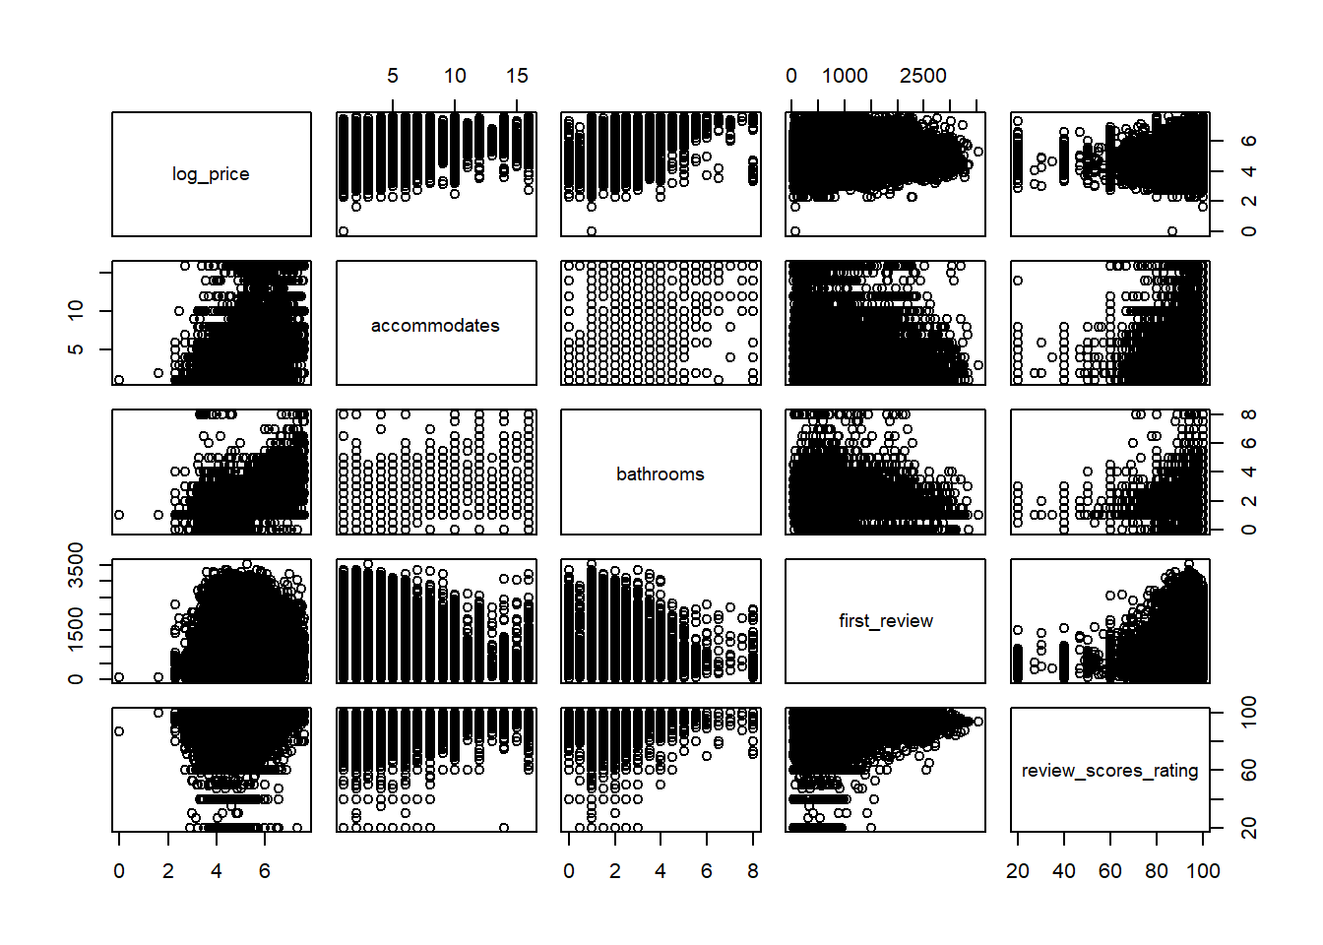
Explore
Multi-variables visualization: significant relationship pattern

Slide 18
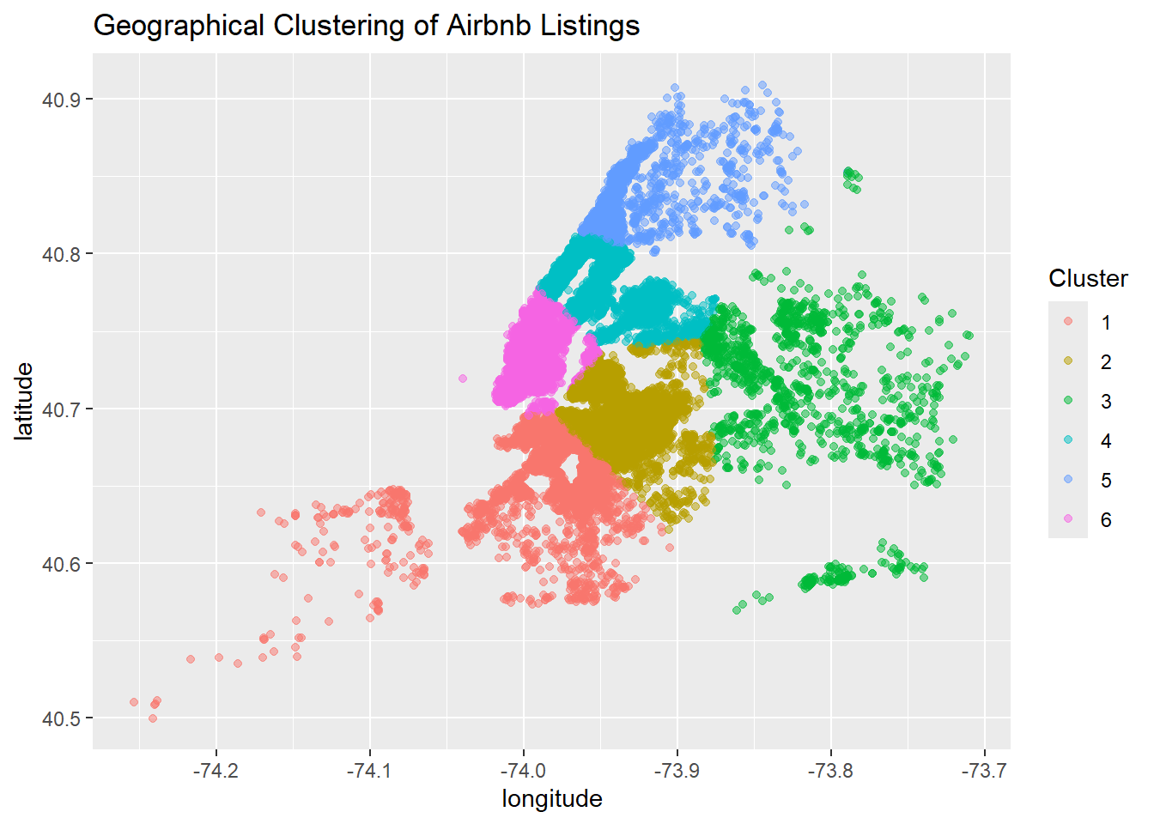
Explore
K-means cluster in NYC

Slide 19
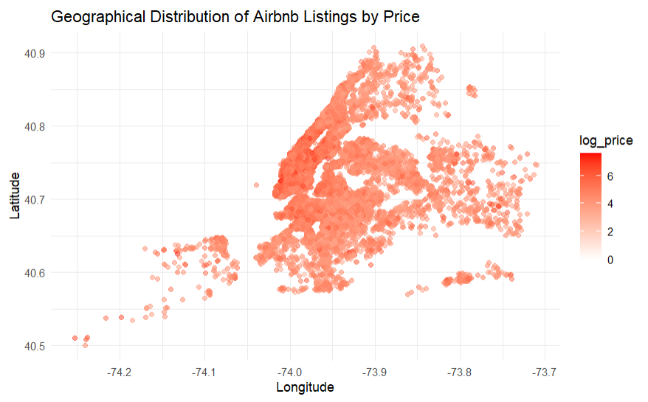
Explore
Prices across latitude and longitude

Slide 20
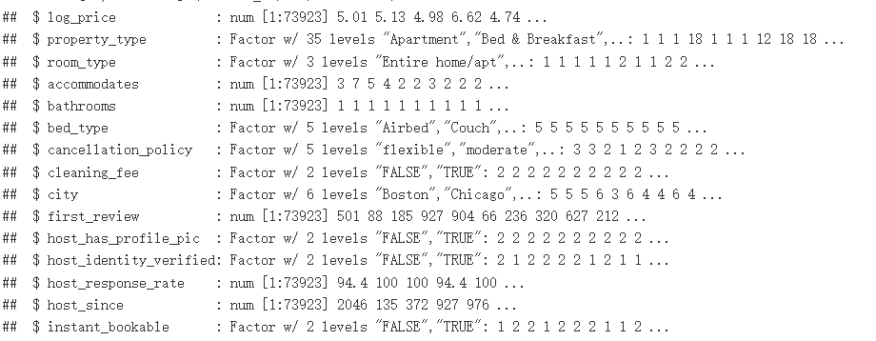
Explore
Simple analysis about category variables

Slide 21
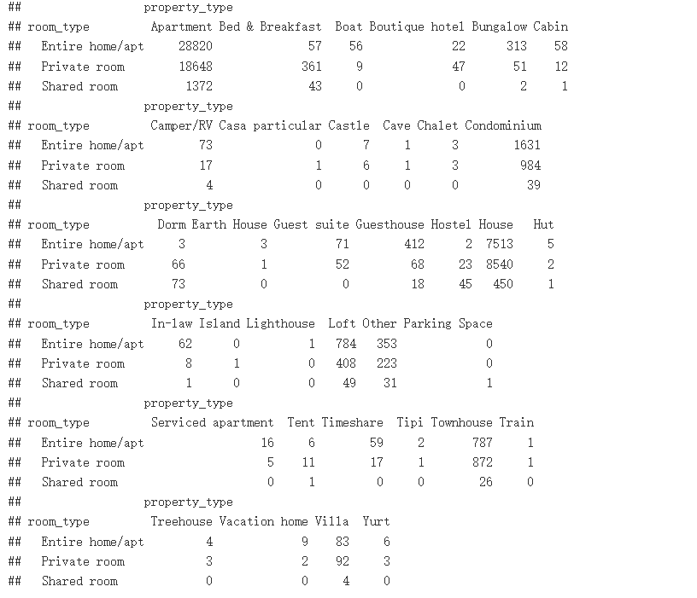
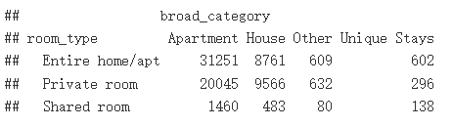
Explore
Apartment
House
Unique Stays
Other

Slide 22
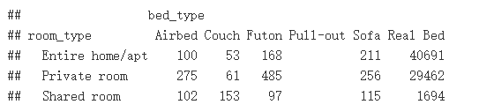
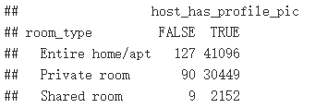
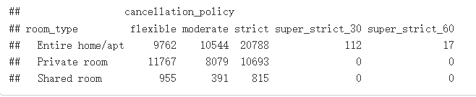
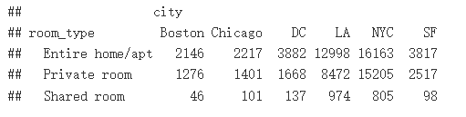
Explore

Slide 23
1 Introduction
2 Data Cleaning
3 Explore
4 Regression Model
5 Insights
6 Conclusion and Extension

Slide 24
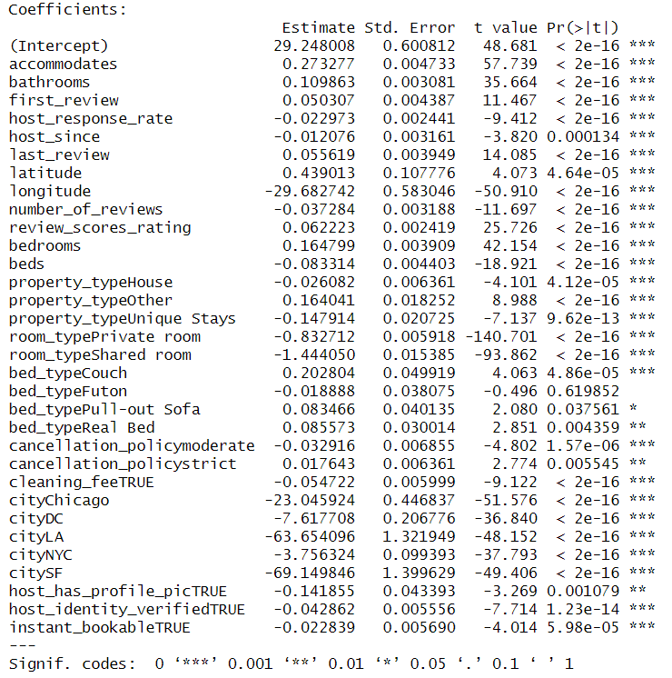
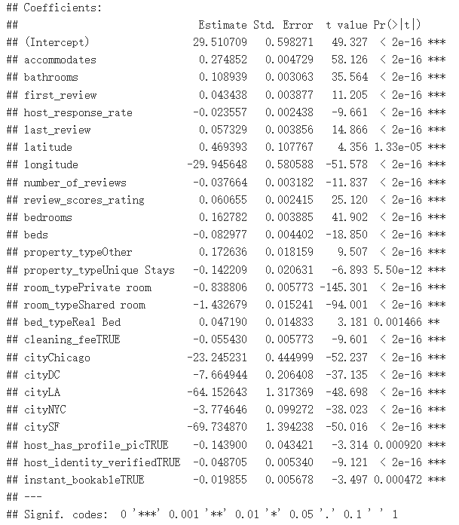
Regression Model
Exclude some insignificant variables

Slide 25
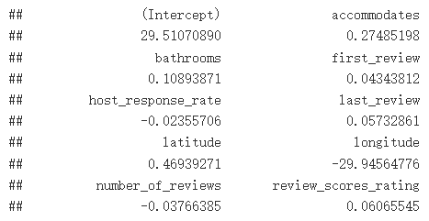
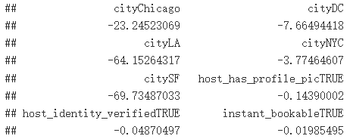
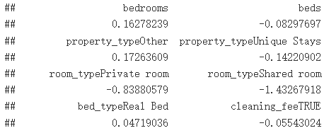
Regression Model
R-squared: 0.58
Find the variables that have coefficients higher than 0.5

Slide 26
1 Introduction
2 Data Cleaning
3 Explore
4 Regression Model
5 Insights
6 Conclusion and Extension

Slide 27
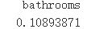
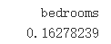
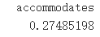
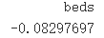
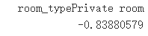
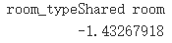
Insights
From the results, there are several intuitive insights.
More bathrooms, bedrooms, accommodates can increase the price.
However, more beds can lead to lower price. It may because more beds implied sharing room.
Shared room and Private room can decrease the price compared with Entire Home/Apt

Slide 28
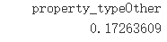
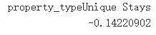
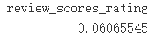
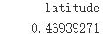
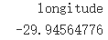
Insights
Also, there are some interesting results.
In property_type, others will increase the price while unique stays decrease the price. We can see some fantastic types in unique stays, such as castle, island. But their price is lower than normal house.
Review scores don’t increase the price significantly. That’s kind of reasonable since we have good lodges in every point of price range.
host_has_profile_pic seems quite significant. It may be caused by amount of data. There are only 1% of hosts don’t have a picture for their lodges.
The latitude and longitude is significantly influencing the price. Which is wield. From the early analysis, we can see that dealing with location related number is difficult.

Slide 29
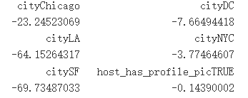
Insights
Finally, we can get the city related influence. Boston is the most expensive city for lodging, followed by NYC and DC. While SF, La and Chicago are much cheaper.
Boston
NYC
DC
Chicago
LA
SF

Slide 30
1 Introduction
2 Data Cleaning
3 Explore
4 Regression Model
5 Insights
6 Conclusion and Extension

Slide 31
Conclusion and Extension
Cleaned up the data set about Airbnb lodges
Analyzed data by preliminary methods like MVA and T-test
Used multiple regression to get a predicting model
Draw some insights from the model
There are some following direction can be explored afterwards.
The influence of property_type can be analyzed further, since the board classification is still crude.
The location of data, namely the latitude and longitude can be explored more. Classic cluster and regression methods may not be able to deal with this part.
About the text type of data, we can use text mining methods to put them to use.

Slide 32
Conclusion and Extension
There is a lots of works before we actually run the regression. We need to clean up the data, explore with many methods for a clear direction.
Analysis is a dynamic process; we need to run the model and do the analysis iteratively.
Finally, I should go to SF, LA or Chicago for a holiday travel. Otherwise, I should prepare for an expensive lodging.

Slide 33
Thank you for your attention!
Tonghua Lin
Email: tonghua.lin@rutgers.edu
Tel: 862-423-9940
Cubicle: 1WP 951A

